Slide 1
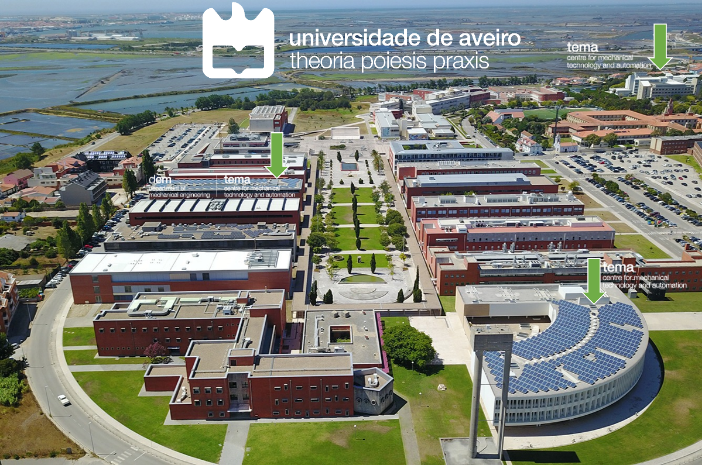


PORTUGAL

Slide 2
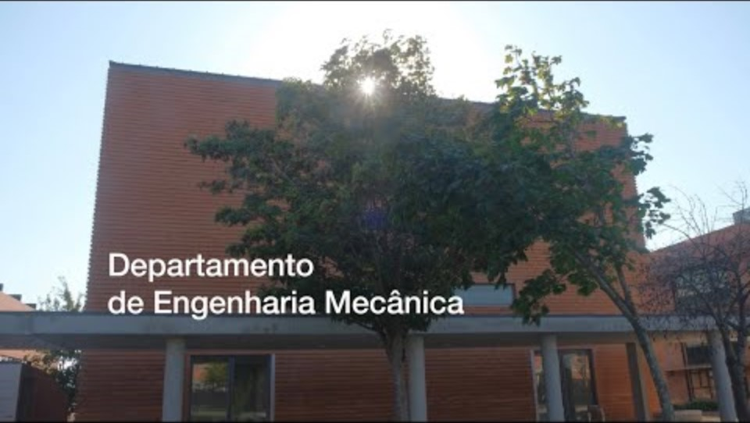

Slide 3

22 – Mechanical Engineering Department
(Research laboratories, classrooms, offices)
Research Unit
Evaluated as Excellent at National level
 | LABORATORY
1 | Mechanical testing (ISO9001 Certified)
2 | Mechanical Technology
3 | Tribology
4 | Structural Dynamics
5 | Flexible Production System
6 | Biomechanics
7 | Product Development
8 | Injection Moulding + Energy
9 | Robotics and Automation
10 | Welding
11 | Thermophysical Properties Characterization
12 | Materialography
13 | Heat Transfer
3 – Building 3
(Research laboratories, offices)
 | LABORATORY
14 | Bio-Manufacturing & Cell Culture
15 | Materials Synthesis
16 | Micro and Nanofabrication
17 | Thermal Materials Treatment
18 | Electrochemistry
19 | X-Ray Analysis
20 | Microscopy and Imaging
23 – Pedagogical complex
(Offices, laboratories)
 | LABORATORY
1 | Transportation
2 | Traffic, emission modeling & life cycle assessment
…and Simulation and modelling (virtual labs)

Slide 4
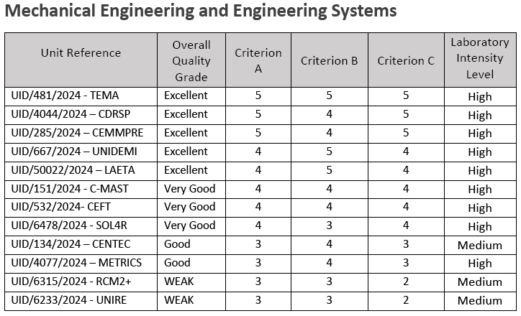
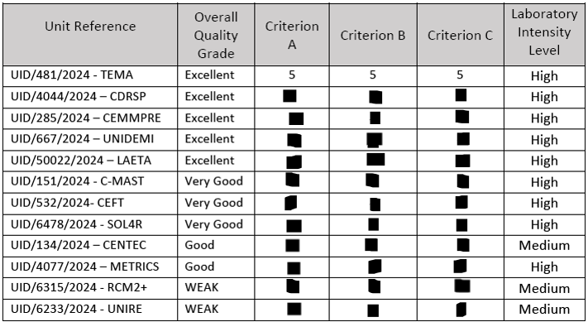
Research Unit
Centre for Mechanical Technology and Automation (TEMA)

Slide 5

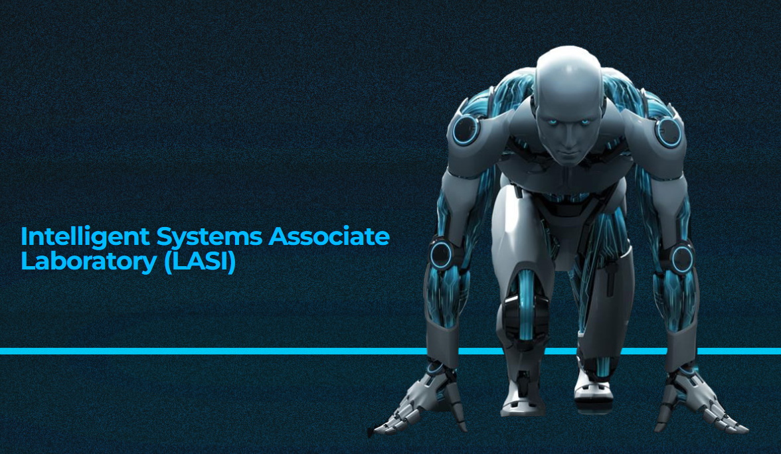
Research Unit
Centre for Mechanical Technology and Automation (TEMA)
Founder Member of Intelligent Systems Associate Laboratory
LASI

Slide 6
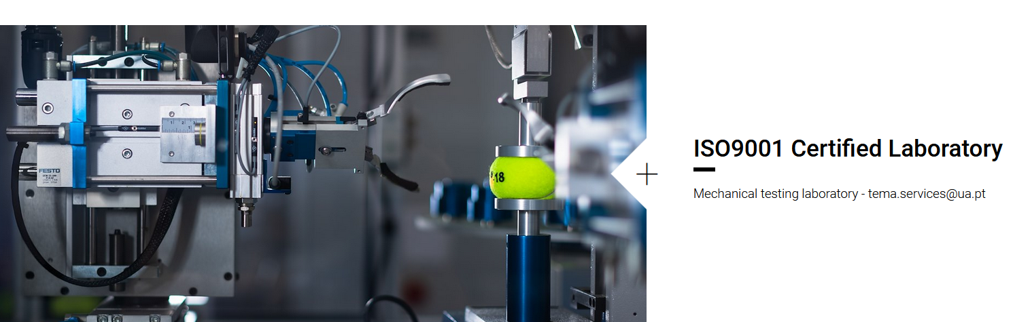
Infrastructures
7th year of certification

Slide 7
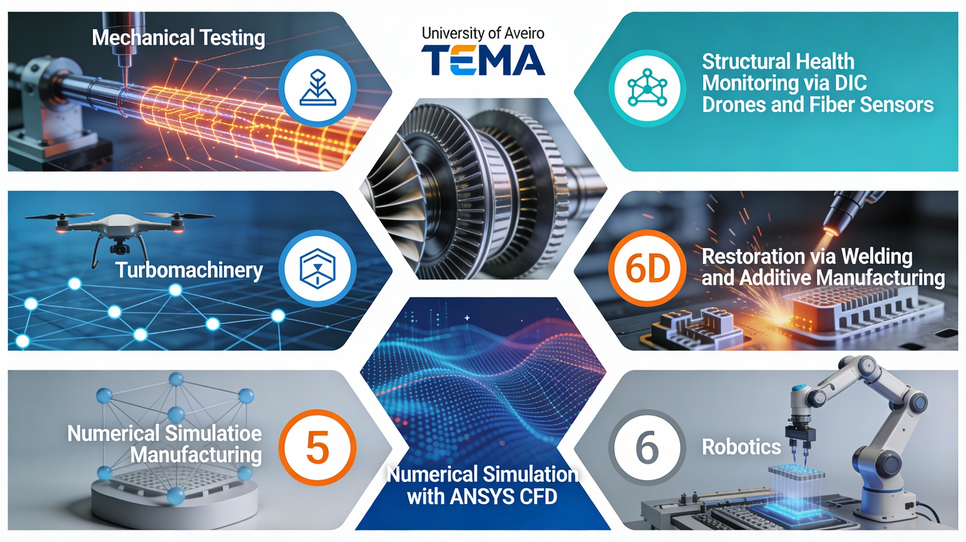

Calibration Techniques for LiDAR and Camera Systems
Vibroacoustic

Slide 8
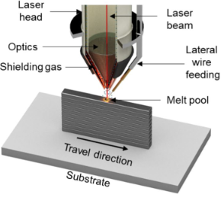
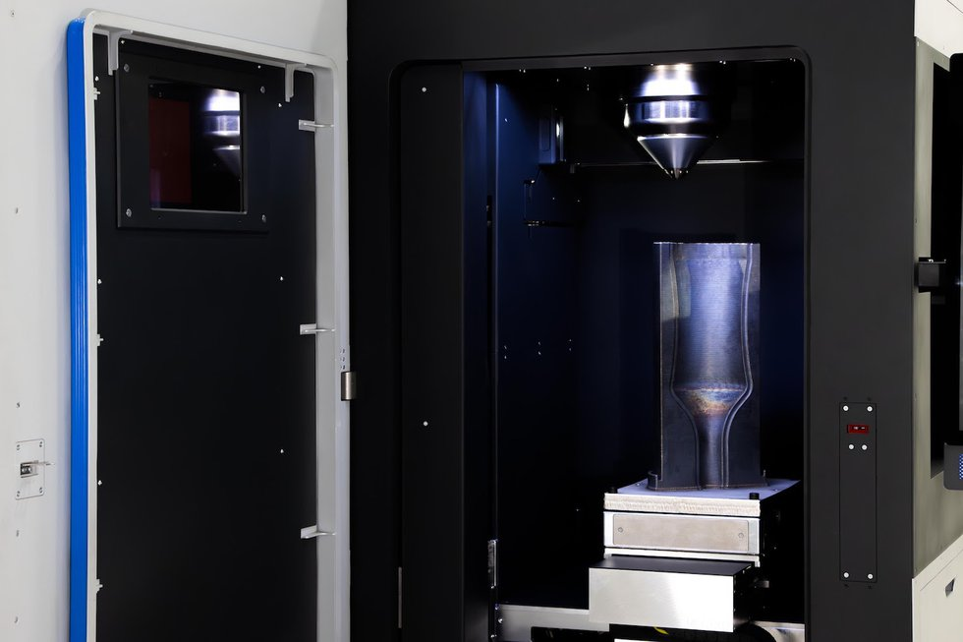
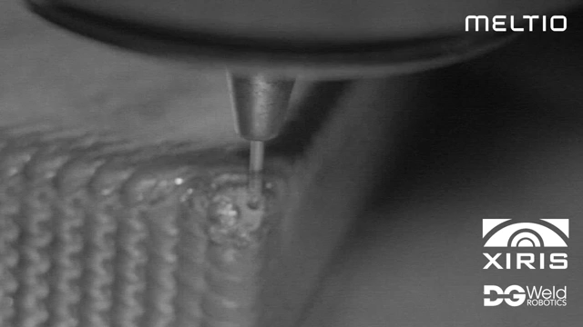
Metal Additive manufacturing Wire – Directed energy deposition (DED)
Blue Laser (445 nm) Aluminium, titanium alloys and pure copper
https://www.youtube.com/watch?v=PvnfrVNcVrw&pp=ygUHbWVsdGlvIA%3D%3D
Meltio M600 – printing volume 300 x 400 x 600 mm

Slide 9

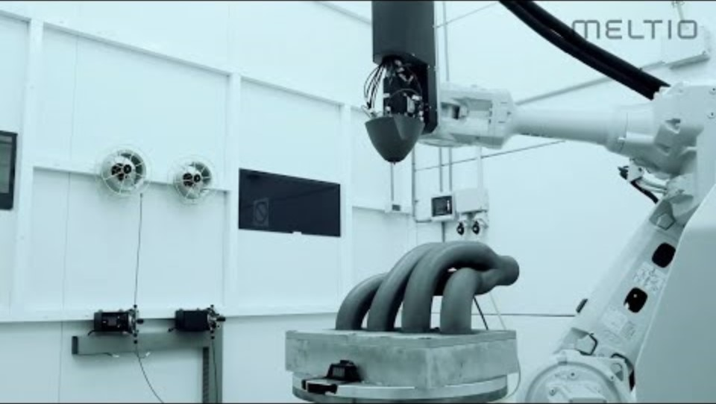
Reparações
Multimaterial
https://www.youtube.com/watch?v=9S5BIjC9Fvs&pp=ygUHbWVsdGlvIA%3D%3D
https://www.youtube.com/watch?v=6BvGbGKGQhI&pp=ygUHbWVsdGlvIA%3D%3D

Slide 10
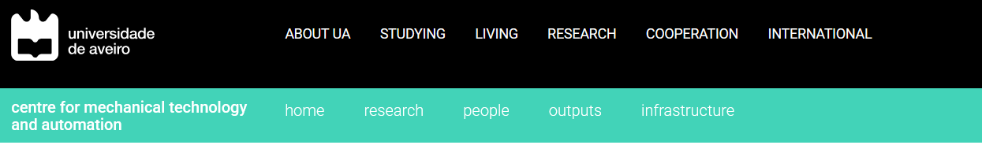
Services
The infrastructure TEMA is able to offer services (e-mail: tema.services@ua.pt) of/in the following laboratories and/or equipment/intervention areas (book of services):
–Mechanical testing laboratory - ISO9001 Certified Laboratory ;
–Mechanical technology laboratory;
–Materials Characterization laboratory;
–Additive Manufacturing and Prototyping Laboratory;
–Building models and prototypes;
–Experimentation in home automation / smart buildings
–Incremental forming thin plate;
–Machining and Tribology laboratory;
–Trials, mechanical tests and numerical modeling;
–Characterization of materials by inverse analysis;
–Plastic anisotropy and constitutive modeling;
–Simulation and experimentation in thermal treatments;
–Mechanical and microstructural analysis of materials;
–Characterization of fluids;
–Impact tests;
–Simulation and experimental sheet forming processes;
–Hydrogen production;
–Nanotechnology laboratory;
–Chemical Vapour Deposition laboratory;
–Analysis XPS, UPS and AES
–Structural Dynamics Laboratory;
–Flexible Production System laboratory;
–Biomechanics Laboratory;
–Computational Injury Biomechanics Laboratory ;
–Simulation and experimentation in biomechanics;
–Development of medical devices;
–Development of implants and its fixation in the bones;
-Characterization of Thermo-Physical Properties laboratory;
-Energy Efficiency Laboratory;
–Sustainable Energy Systems laboratory;
–Welding laboratory;
–Metallography laboratory;
–Implementation and testing of welded constructions;
–Implementation and testing of adhesive joints;
–Topological analysis and optimization of mechanical structures
–Development of processes for industrialization of products;
–Test of sensors for car and oil industry;
–Development / experimentation of industrial equipment;
–Equipment failure analysis;
–Testing internal combustion engines;
–Cogeneration systems;
–Evaluation and monitoring of emissions / energy consumption / use of alternative energies;
–Analysis of performance and life cycles;
–Experimental stress-strain analysis;
–Biaxial tests in rolled carbon;
–Synthesis and modeling of nanocrystalline materials;
–Micromechanics analysis and modeling of composites laminates;
–Homogenization properties of composite materials;
–Diamond coatings;
–Production of fuel cells;
–Synthesis of nanocarbon material;
–Use of graphene and modified compounds;
–Manufacture of shape memory polyurethanes;

Slide 11
Equipments and Technical Analyses for Mechanical Properties determination:
Universal testing machine Shimadzu UH-FX 1000 kN
Universal testing machine Shimadzu UH-FX 100kN
Universal testing machine Shimadzu AG-50kN
Universal testing machine Shimadzu AGS-X-10kN
Oven for tensile testing Maytec
Thermostatic Chamber TCE-N300
Impact machine-10kN
Fatigue testing machine –5kN
Nano-indentation and Micro-Scratch tester CSM-MST
Shimadzu micro-material testing machine MMT-101N
Biaxial testing machine –10kN
Biaxial testing machine –100kN
GOM ARAMIS 3D 5M
Measurement device GOM ARGUS 12M
32-channel extensometer acquisition system
Dynamic Mechanical Analyzer
Axial torsion test machine
Materials Processing Techniques and Manufacturing:
Asymmetric rolling
Plastograph EC Brabender
Thermo Scientific HAAKE MiniJet II
Plastic injection molding machine
Electrospinning Mecc Nanon–A01
PowderPro freeze granulator
Single point incremental forming machine
Welding equipments:
Electron beam welding equipment
Robotic blue laser welding equipment
Robotic MIG/MAG welding equipment
Welding pulsed laser
Ultrasonic metal welding equipment
Technical analyses and Thin films deposition:
AFM Imaging and local physical characterization
CVD thermal and hot-filament (max. 1000ºC)
Thermal CVD 1500ºC
Multi-technique XPS/UPS and AES
Laurell Automated Spin Coater
Thermal treatments, oven and furnaces:
Drying oven
Vacuum heater
Freeze-dryer lyophilization
Accelerated weathering tester
Equipments for Cell culture protocols:
CO2 incubator
Cell counter
Centrifuge
Autoclave
Q-Sense E4 quartz crystal microbalance
Equipments for cell fuel materials characterization:
Fuel cell characterization
Fuel cell testing
Sievert Hydrogen Storage
Technical analyses for Thermal properties determination:
Thermal analysis Netsch Jupiter TGA/DSc
Calorimeter
Melt flow indexer
Differential scanning calorimetry
Thermal Conductivity Meter
Gas chromatographs PerkinElmer Clarus GC
Quantachrome porometer 3Ghz
Thermal Camera
Infrared camera FLUKE TiX580
Biomechanics equipments:
Hip joint and wear simulation
Fatigue, traction and compression machine
Multiaxial dynamique fatigue testing machine
Muscular simulation machine
Multidirectional electro-mechanical test machine
Test apparatus of the knee joint
3D printing machines:
3D laser scanner
CNC coordinate measuring machine
4-axis CNC milling machine
ZPrinter 310 Plus (BJ) 3D printer
Ultimaker S5 FDM 3D printer
Microscope equipments:
Optical microscope Nikon Eclipse
Scanning Electronic Microscope Hitachi Tabletop
Rheology measure equipments:
Rheometer
Viscometer
Density meter
Technical analyses for Materials characterization:
UV spectrophotometer
X-Ray diffraction system
Desk-top X-Ray Microtomograph
Digital X-ray component analysis equipment
Air analyses equipments:
Aerosol monitor
Indoor air quality monitor
Water Vapor Sorption Analyzer
Microclimate data logger
Airflow meter for ventilation systems
Pyranometer
Others Equipments:
Bragg fiber optic measurement system
Oil Dielectric Breakdown Tester
Power quality and energy analyzer
Nanovoltmeter
Manual wafer probe station
HD Camcorders and GPS data logger
Portable Olympus Omniscan SX phased array
Leak test instrument (ATEQ F620)

Slide 12
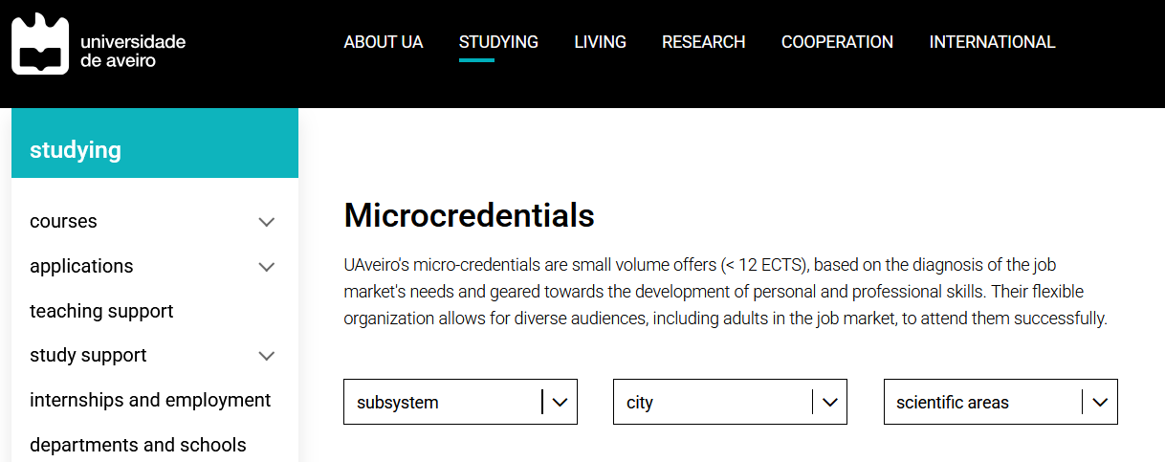
Additive Manufacturing and 3D Printing
Additive Manufacturing Techniques & Design for Additive Manufacturing
Advanced Characterization Techniques for Materials applications available
Advanced Data Analytics and Forecasting
Applied machine learning
Artificial Inteligente for Business applications available
Assessment of, for, and as Learning in the context of STSE/STE@M education
Cam Programming - 2, 3 and 5 Axis Machine Strategies
Celular Networks Concepts
Challenge-based Learning and STSE/STE@M Education applications available
Characterization of Microwave Devices and Antennas
Circuit Analysis and Instrumentation in DC Mode
Circuit Analysis and Instrumentation in Steady-State Sinusoidal Regime
Communication for Leadership
Communication Strategies for Innovative Professionals
Content and Media Management and Analysis
Deposition of Micro and Nanostructured Materials applications available
Design and innovation for sustainability
Digital educational resources in CTSA/STE@M education contexts
Digital Technologies to Support Design, Implementation and Operation
Direct and parametric CAD modeling
Education for creativity through a STSE/STE@M-oriented approach
Energy Transition and Sustainable Energy Systems
Flexible learning environments in STSE/STE@M educational contexts
Foundations of Data Science
Fundamentals of Machine Learning
Hydrogen Fundamentals and Operations
Indroductory welding course
Industrial Robotics
Information Management in Science, Technology and Innovation
Intellectual Property and Licensing
Interaction Design for eXperience
Introduction to Artificial Intelligence in Industry
Introduction to Artificial Vision in Industrial Applications applications available
Introduction to Virtual and Augmented Reality
ISO management system standards in practice
Laser Technology
Leadership in digital transformation
Location on Celular Networks
Methods and strategies for active learning and teaching in CTSA/STE@M education
Modelling and Simulation for the Industry
Moving Image Digitalization Technologies
Process Modelling based on BPMN: a path to Digital Transformation
Programmable PLCs and Human-Machine Interface
Programming in Robot Operating System (ROS) applications available
Project Mangement
Project-Based Learning and STSE/STE@M Education applications available
Prototyping Interactive Products
Python Programming for Data Analysis
Research on pedagogical practices in STS/STEAM education
Resilient Structures
Satellite Communications
Satellite Systems
Science, Technology and Innovation Policy and Instruments applications available
Seismic Assessment of Existing Reinforced Concrete Buildings
Smart Algorithms for Industrial Data
Smart Digital Construction
Virtual Reality Interfaces
Welding Practice Course

